Slide 1

Your past, your present and your future

Slide 2


Slide 3
IDEA
What is Capsulefy?

Slide 4





Time capsule

Slide 5


Payment plans
 | Free | Premium
Price | 0 € | 11.99 €
Storage | 20 MB/user | 500 MB/capsule
Social network and email integration
Capsule scheduling | 1 year | No limit
Capsule expiration | 6 months after release | No expiration
Modular and private capsules

Slide 6



We offer…
Social network integration
Email integration
Deadman switch

Slide 7
DEMO
How does the system look like?

Slide 8
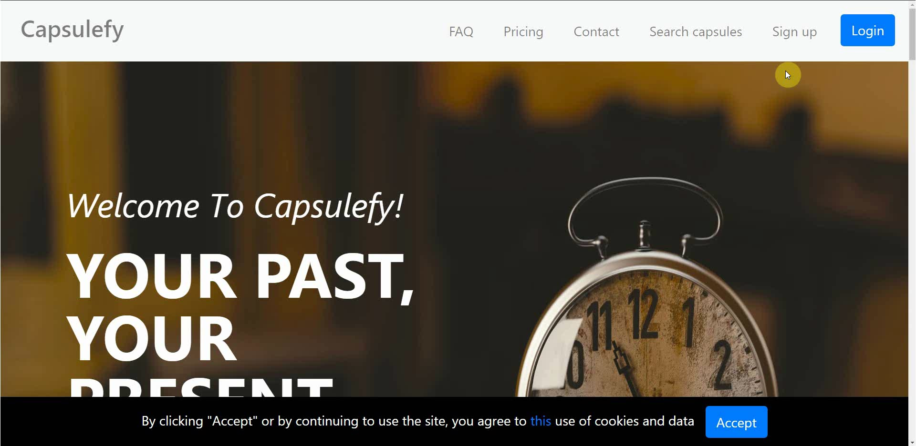
No logged user – Sign up

Slide 9
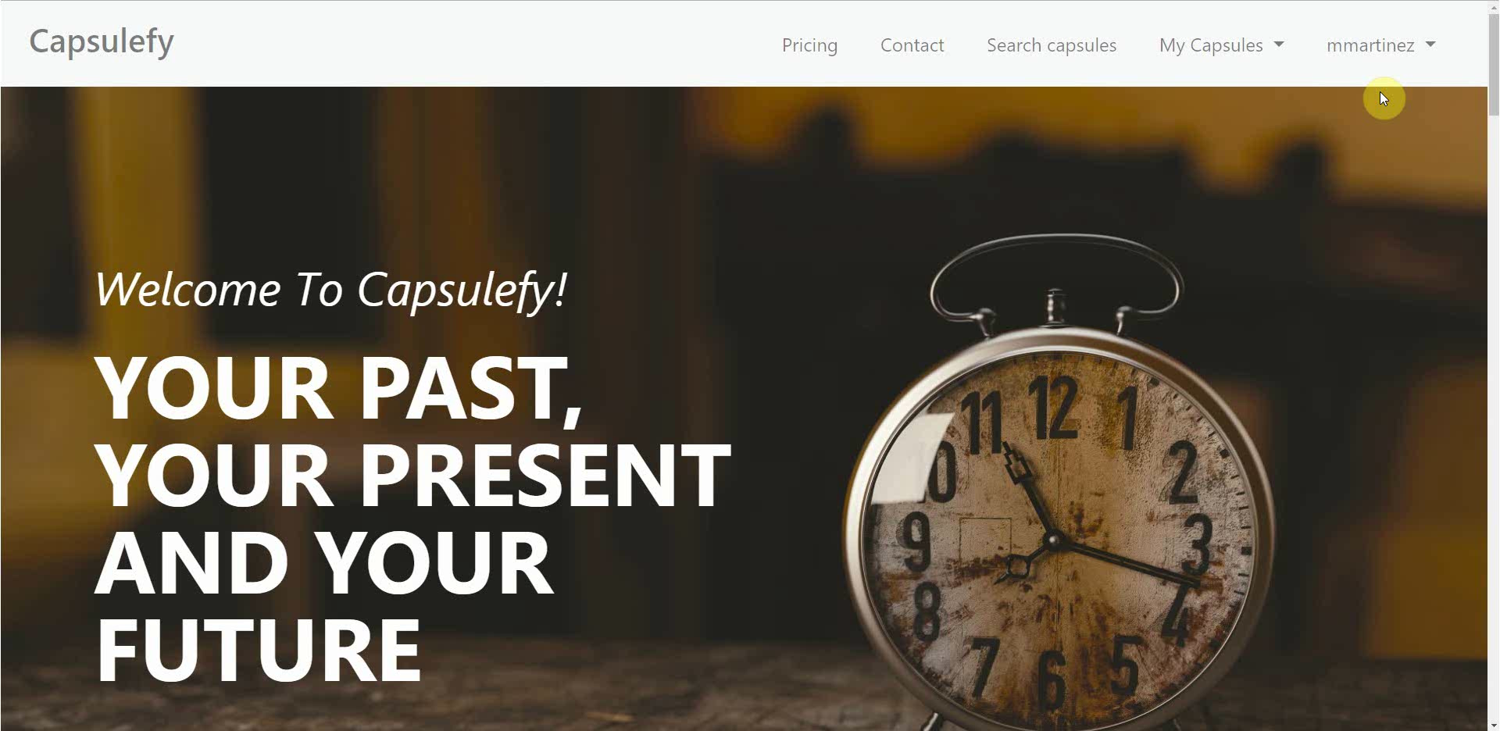
Logged-in user – Connect to Twitter

Slide 10
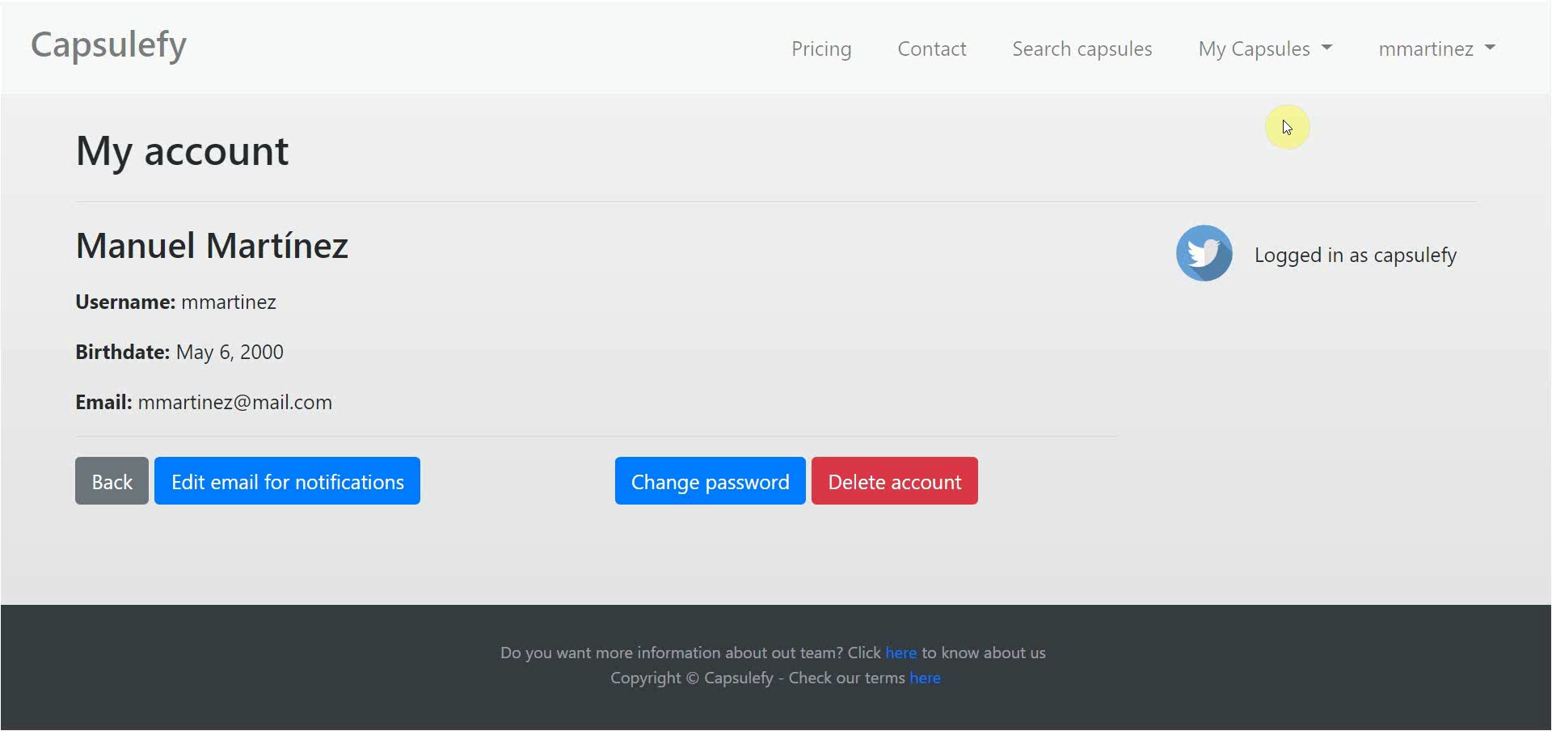
Logged-in user – Create capsule

Slide 11
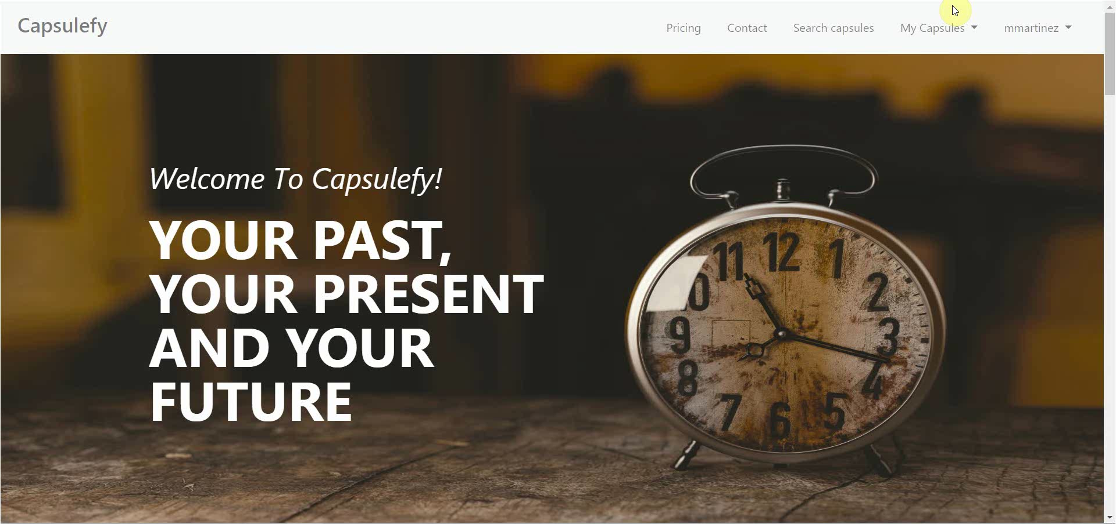
Logged-in user – Refresh timer

Slide 12
TEAM
Who is behind?

Slide 13
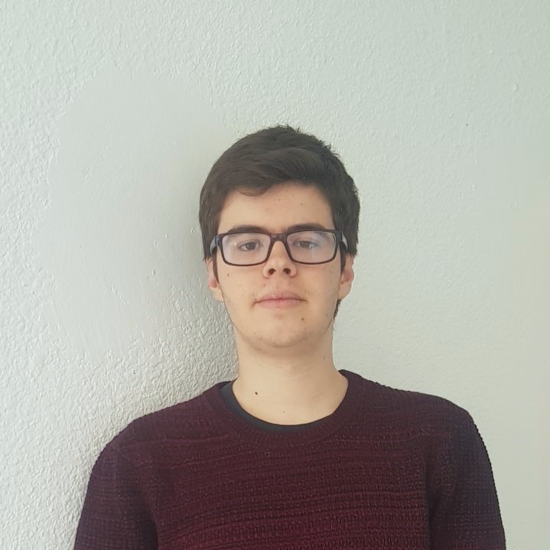






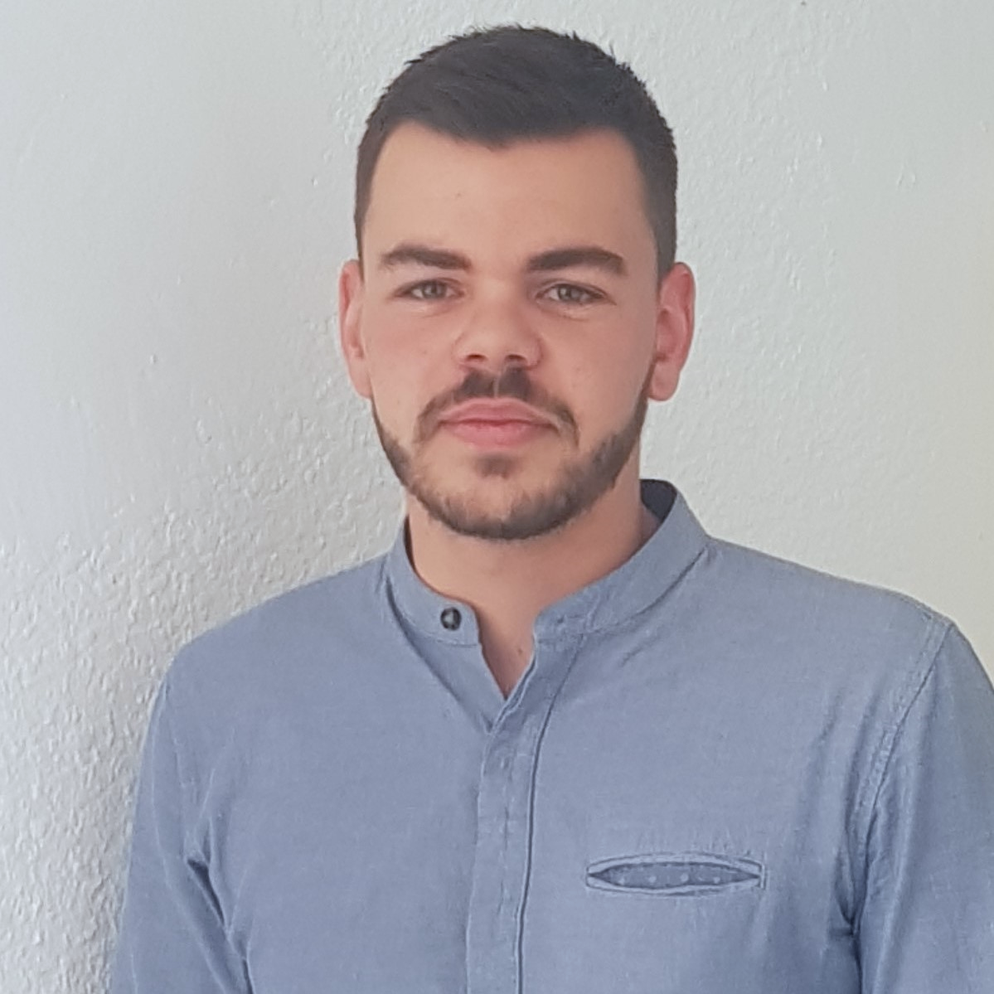



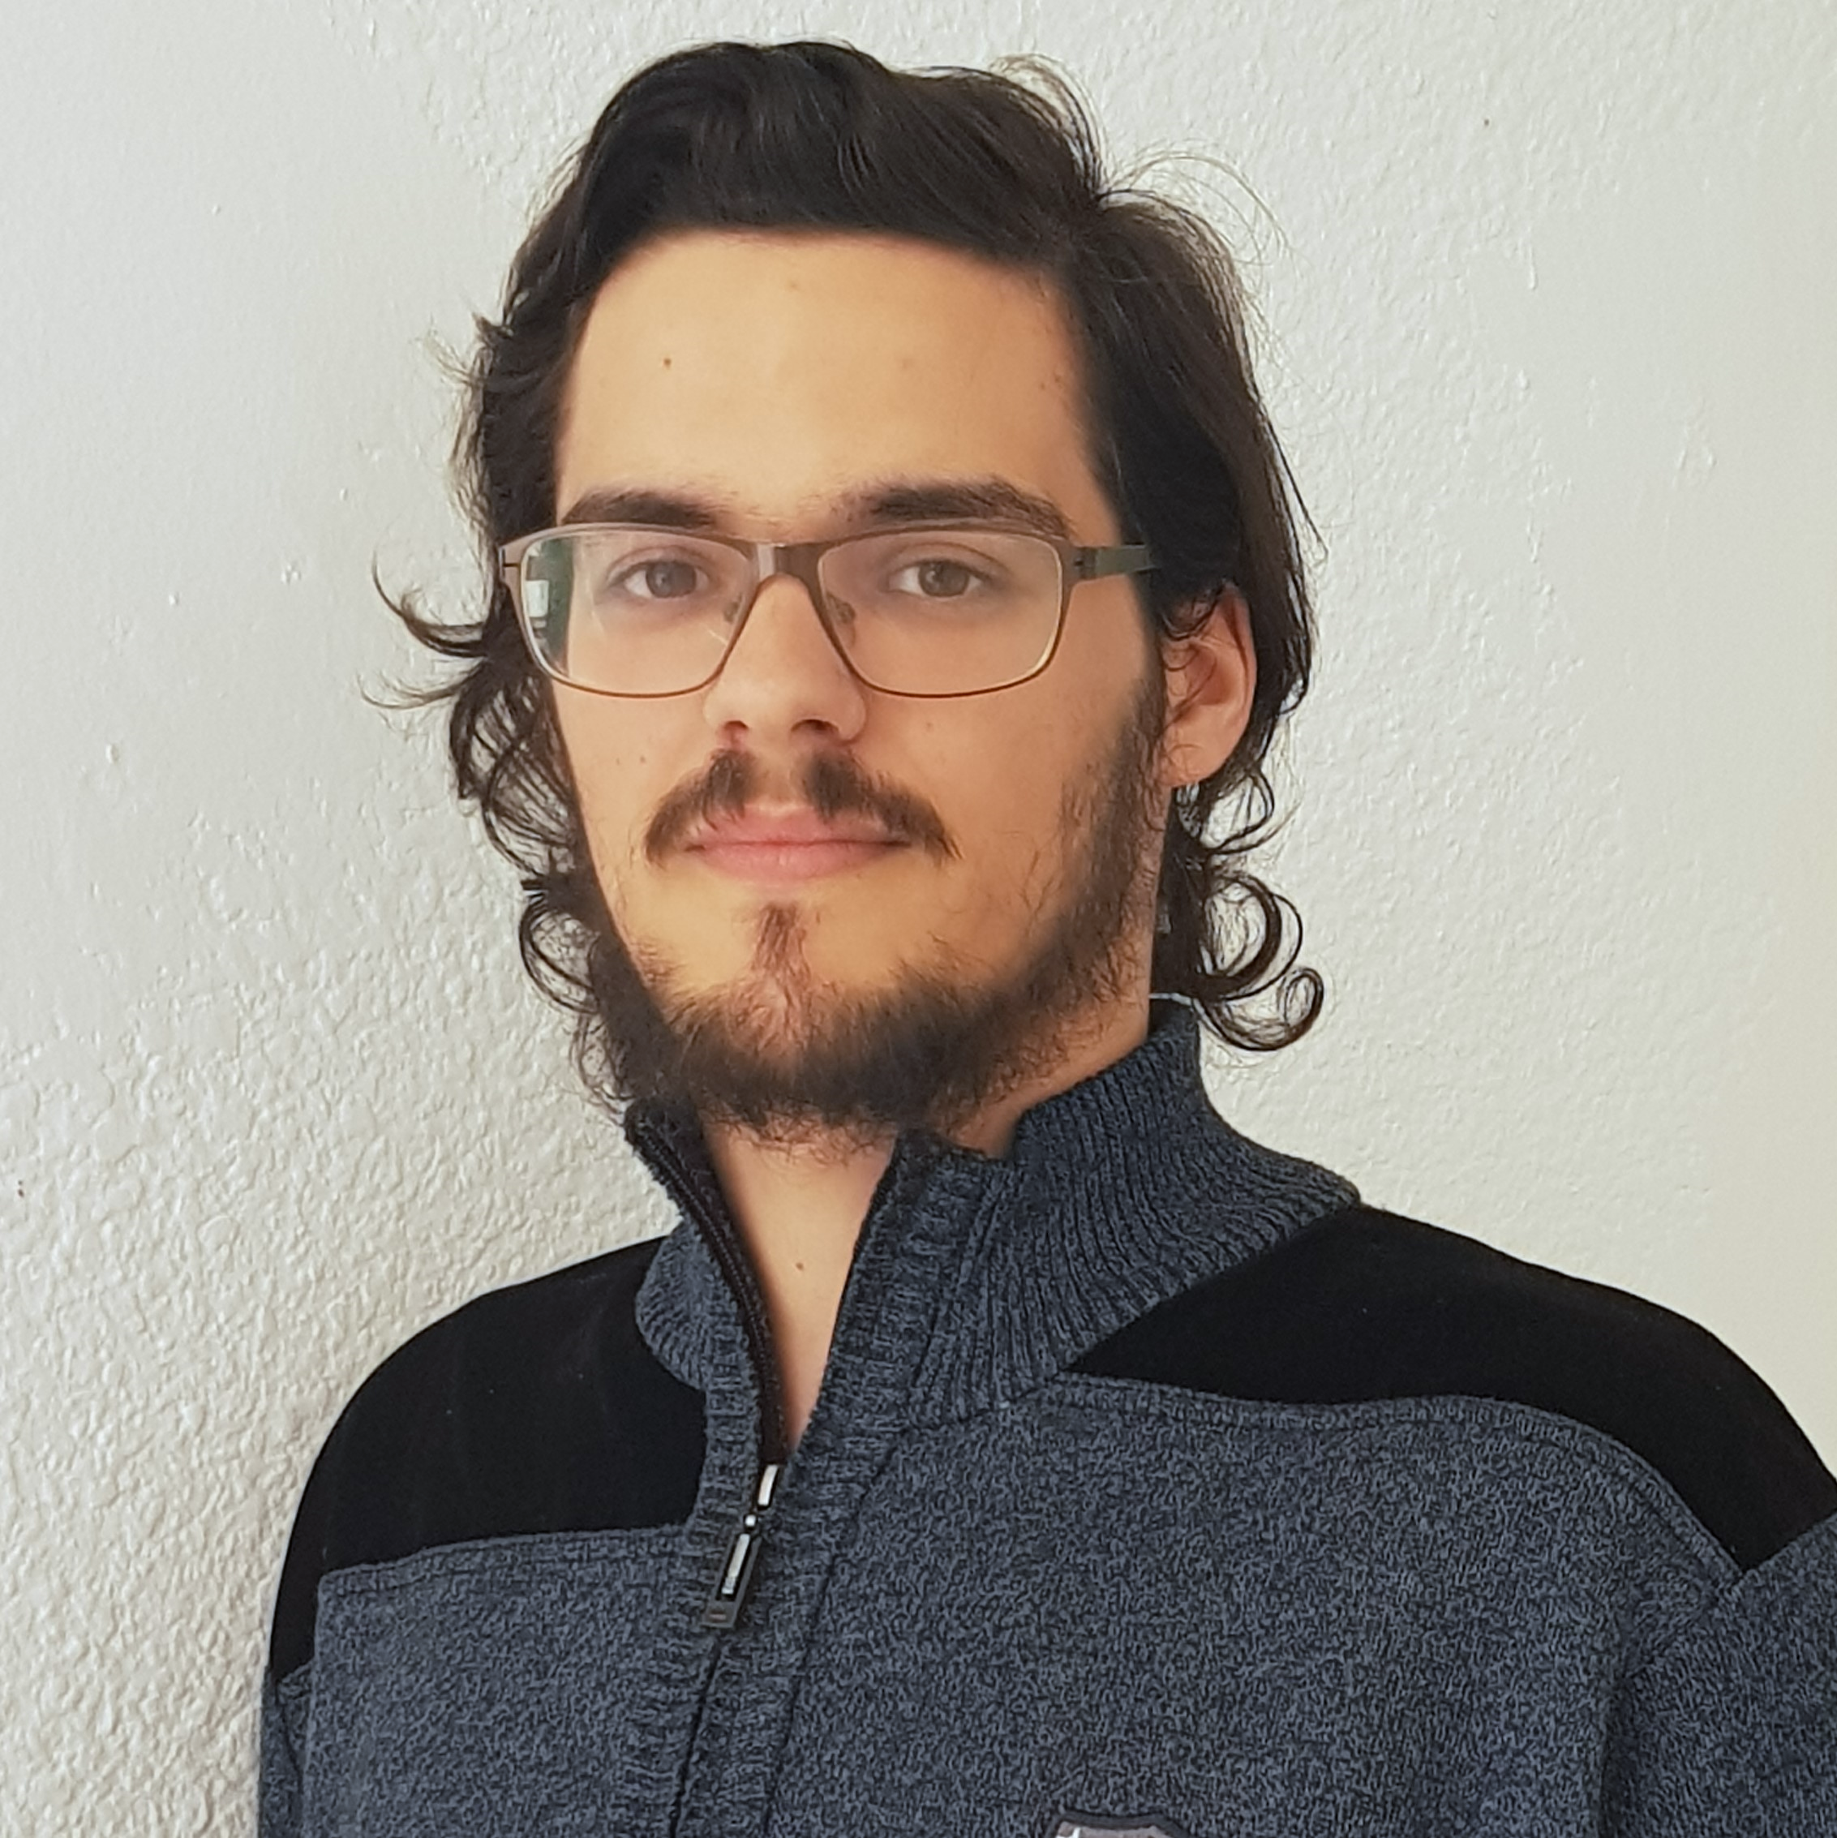



Pablo Rebollo
Project manager, backend developer
Juan Rodríguez
Requirements engineer, backend developer
Adrián Cantón
Business manager, full-stack developer
Rafael Fresno
Backend developer, API integration
Daniel Carpio
Analist,
frontend developer

Slide 14
Try it now!

Slide 15
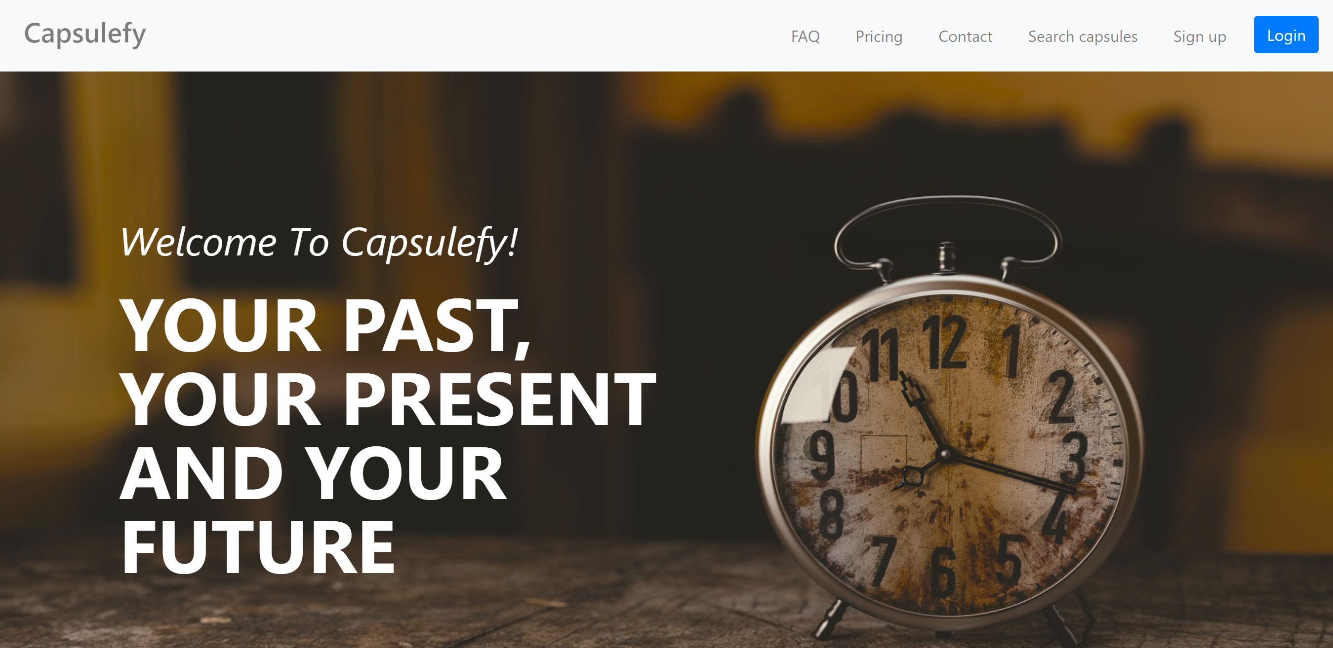
https://capsulefy.herokuapp.com

Slide 16
Thanks!
https://capsulefy.herokuapp.com
Landing page: https://capsulefy01.herokuapp.com
Contact email: capsulefy.communications@gmail.com
GitHub releases: https://github.com/pabreblob/capsulefy/releases

Slide 17
COMPETITORS
What makes us different?

Slide 18
 | Viajeros en el tiempo | Mytimecapsule | Miigen | thetimecapsule | Capsulefy
Automatic content publication
Free plan
Premium plan
Images
Videos
Social network integration
Deadman switch

Slide 19
 | Milegadodigital | Capsulefy
Not restricted to last wills
No family certificate required
Free plan
 | Mytimecapsule | Milegadodigital | Capsulefy
Price | 8.97 € | 79 € | 11.99 €
Features | 100 MB storage | Online last will basic plan | 500 MB storage

Slide 20
SWOT analysis
What are our strong and weak points?

Slide 21





Strengths
Deadman switch
Highly customizable
Free plan
More storage

Slide 22




Weaknesses
New to the market
Written last wills
Hard to understand
Only PayPal

Slide 23




Opportunities
No monopolies
Insurance companies
Special days
Wide target

Slide 24




Threats
Competitors
Lack of trusts
Infrastructure
Not enough users

Slide 25
Return of investment
How are we making profit?

Slide 26
Project duration | 14 weeks
Salaries | 14,390 €
Equipment | 325 €
Hosting | 669 €
Advertising | 3,060 €
Customer support | 18,729 €
Risk prevention | 10% (2,724 €)
Total | 36,168 €

Slide 27



During our 1st month…
100-200 capsules sold
First week free
20% discount during next three weeks
Total revenue: ~1,140 €

Slide 28


During our first 6 months…
700 capsules sold
~500 capsules at full price
4,750 € during this period
Total revenue: ~5,990 €

Slide 29
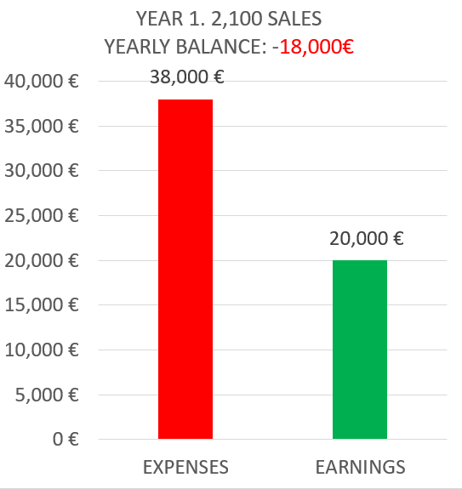
During our next 6 months…
3,060 € for advertisement campaign
~1,400 sales
13,300 € during this period

Slide 30
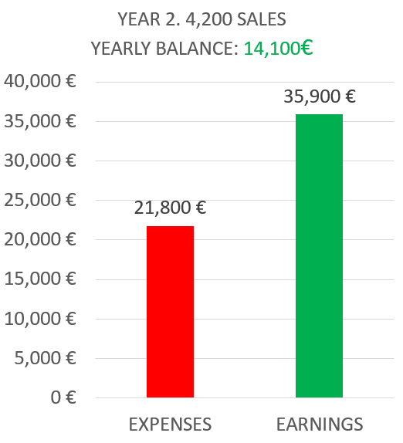
During our second year…
Some discount campaigns
Hosting, advertising and customer support
Double the first year sales

Slide 31
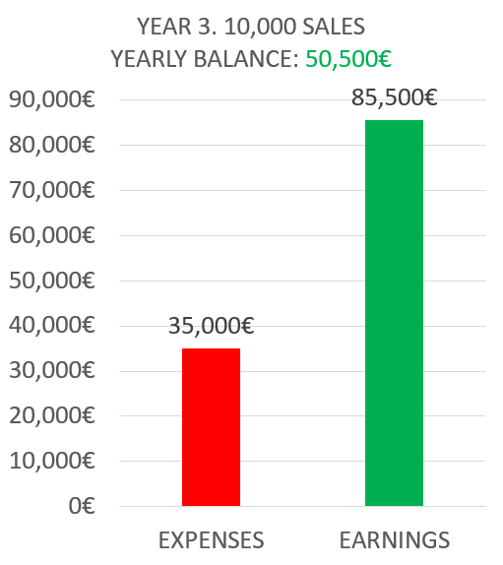
During our third year…
Aggressive expansion plan
Double the marketing budget
Increase maintenance costs

Slide 32
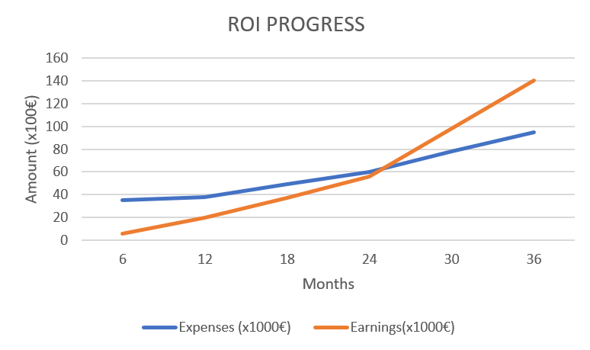

Slide 33
Investment analysis
What is our commitment to investors?

Slide 34

As of today…
35k € invested in development
20k € remaining
Need to find investors for 55k €

Slide 35


Our compromise
Investors get 110% back
We need to return 60k €
Amount achieved after 3rd year
Then, investors get a percentage based on their inversion
%

Slide 36



Our conditions
Minimum 500 € inversions
Initial loan of 20k €
More loans or reduced budget if needed

Slide 37
Deliverable results
What was produced?

Slide 38



Final version:
https://capsulefy.herokuapp.com
GitHub release:
https://github.com/pabreblob/capsulefy/releases (Release 6)
All related documentation

Slide 39
Thanks!
https://capsulefy.herokuapp.com
Landing page: https://capsulefy01.herokuapp.com
Contact email: capsulefy.communications@gmail.com
GitHub releases: https://github.com/pabreblob/capsulefy/releases

Slide 40


Deadman switch
ON

Slide 41
TECHNOLOGIES
What stack do we use?

Slide 42


Web app
Users and capsules
Media storage
Social network

Slide 43
COSTS
How much does Capsulefy cost?

Slide 44
Project duration | 4 months
Salaries | 20.80 €/hour
Hours per month | 40
Equipment | 306 €
Hosting, advertising and support | 18,729 €
Risk prevention | 10% (2,724 €)
Total | 44,968 €

Slide 45



Teamwork
Skills
Profitable work
Positive feedback

Slide 46
Realistic | 44968 – 46330 €
Optimistic | 43061 €
Pesimistic | 49054 €
Project duration: 4 months

Slide 47




Risk | Mitigation
Broken computer | Risk prevention funds
Changing terms of use | Monitor
Servers down | Monitor
Incompatible timetables | Reschedule

Slide 48
Year 1: 2000 sales
Balance: -25168 €
Year 2: 4000 sales
Balance: 11441 €
44968 €
39600 €
28159 €
19800 €
Costs
Earnings
Costs
Earnings

Slide 49
Year 3: 8000 sales
Balance: 36450 €
79200 €
29023 €
Costs
Earnings

Slide 50


What do we store?
Users:
- Full name
- Email
- Birthdate
- Notification email
- Social network token
Capsules:
- Content
- Files
- Emails
- Payment ID

Slide 51



Create manual
Create test suite
Test the system
Gather feedback
Fill form

Slide 52
Sprint 2
Users receive and fill form
March 30 – April 6
Development
April 8 – April 12
Receive users feedback
April 6
Planification
April 8

Slide 53
Sprint 3
Easter Week
Users receive and fill form
April 12 – April 22
Development
April 22 – May 3
Receive users feedback
April 22
Planification
April 22

Slide 54



GDPR and measure calculation costs are included in the corresponding members’ salaries

